Slide 1
Nez Perce
Indians of the Plateau
Pictures
taken from the Library of Congress

Slide 2
Climate & Region
Plateau Region
Just west of the Rocky Mountains
What is now Idaho, Oregon, and Washington
Plateaus are elevated plains or flatlands
Contained rich valleys and rivers

Slide 3
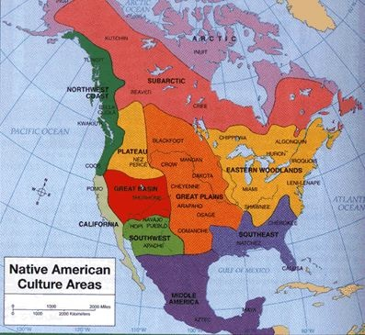

Slide 4
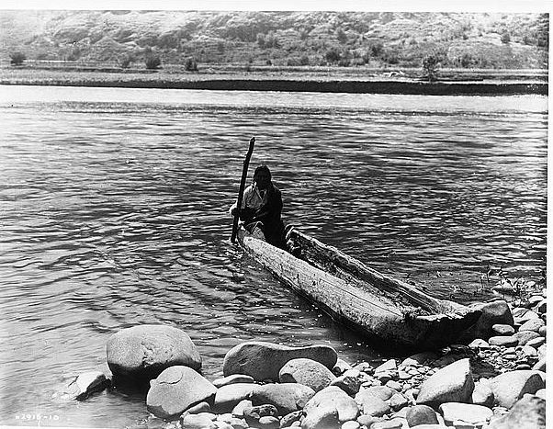

Slide 5
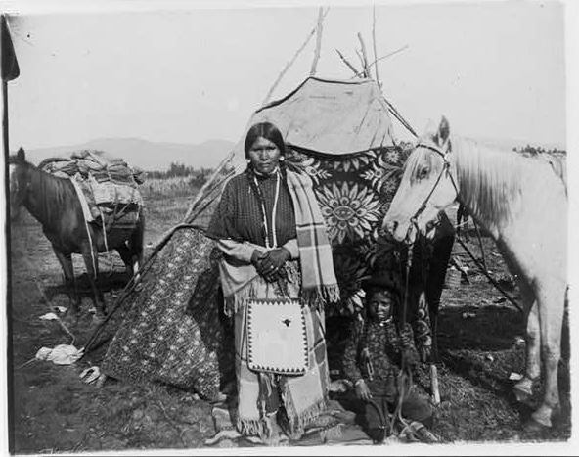

Slide 6
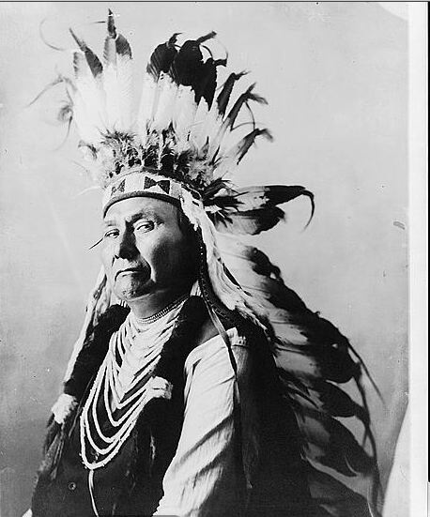

Slide 7
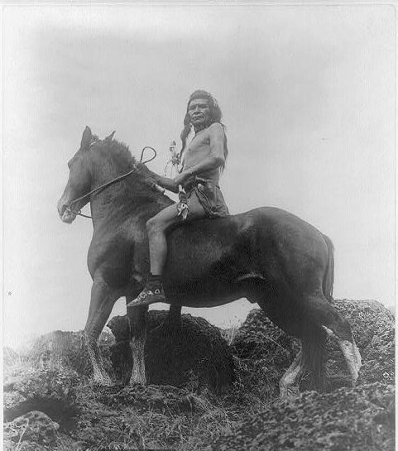

Slide 8
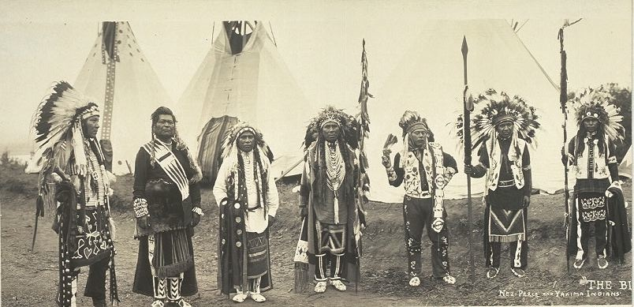

Slide 9
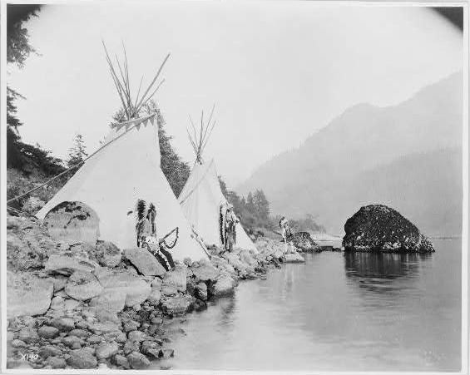

Slide 10
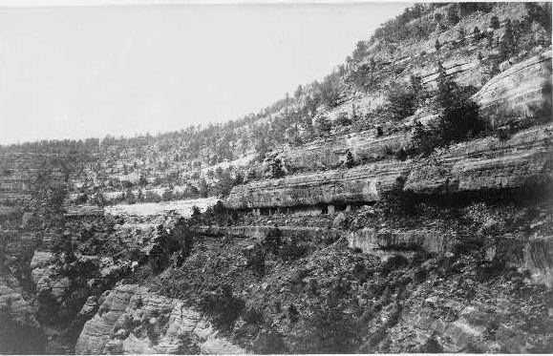

Slide 11
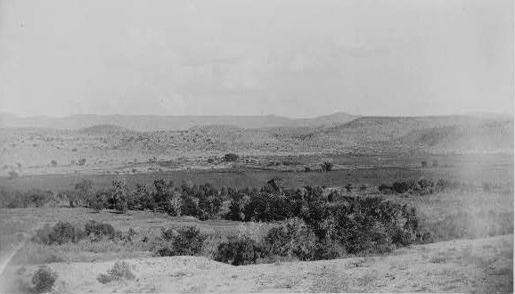

Slide 12
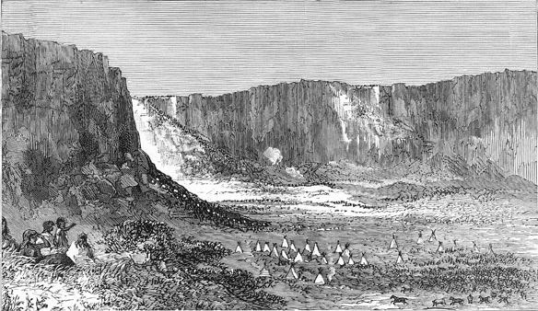

Slide 13
What did you observe about the food, clothing, and shelter of the Inuit Indians?
Where did they live? How did that impact the way in which they lived?

Slide 14
Food
Berries, roots, nuts
Men used spears to fish streams and rivers for salmon and fish
Deer, elk, moose, and buffalo

Slide 15
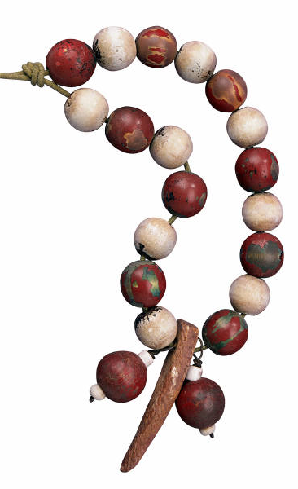
Clothing
Animal Skins
Hides from deer to make dresses for woman
breech cloths, leggings, and shirts from buck skins
Decorated with beads, shells, and paint or dyes
Moccasins

Slide 16
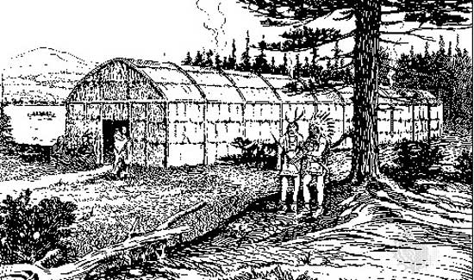
Shelter
Longhouses
Earth Lodges
Teepees

Slide 17
On your chart…
Food | Clothing | Shelter
All kinds of animals (buffalo, sheep, goat), berries, roots, seeds | Clothes out of buffalo skin, moccasins | Lodges out of dirt, Longhouses, teepees

Slide 18
